Slide 1
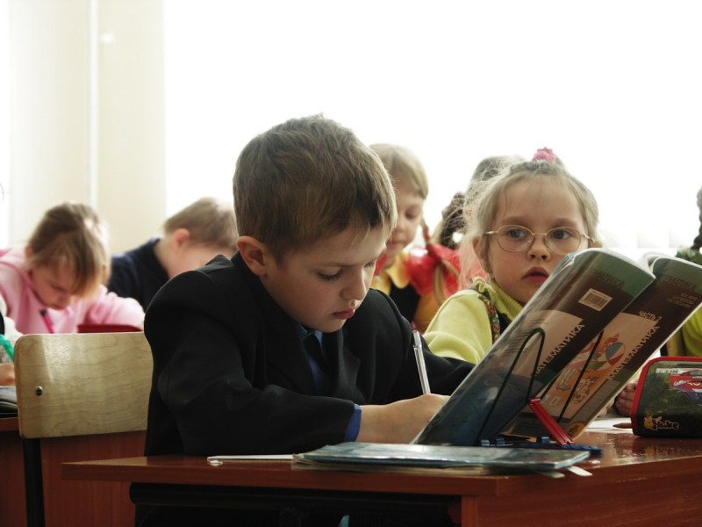
The project of the federal law “About education in the Russian Federation” has been submitted to the public discussion since December 1. For a year and 2 months while the document had an access in the Internet, more than 10,000 amendments had been proposed to it.

Slide 2
Priority directions in the sphere of language teaching for the nearest years:
Early foreign language teaching.
Net forms of educational program realizations.
Use of various educational guides, including electronic ones.

Slide 3
New teaching technologies
1. Learning in cooperation
2. Communicative technologies
3. Critical thinking technology
4. New test technologies
5. Information technologies
6. Health saving technologies

Slide 4
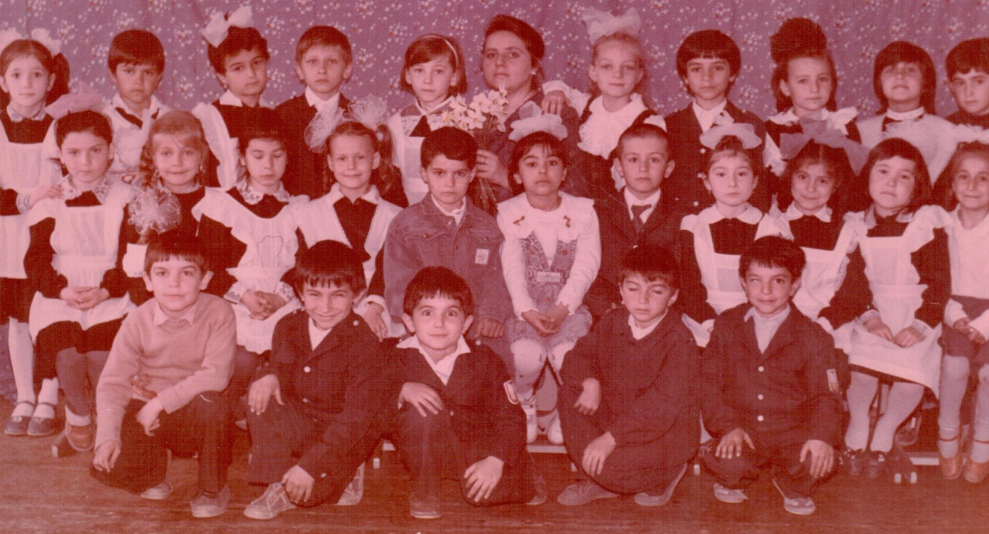
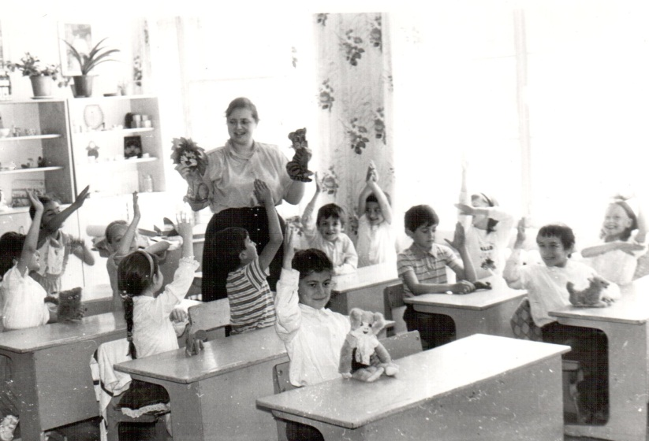
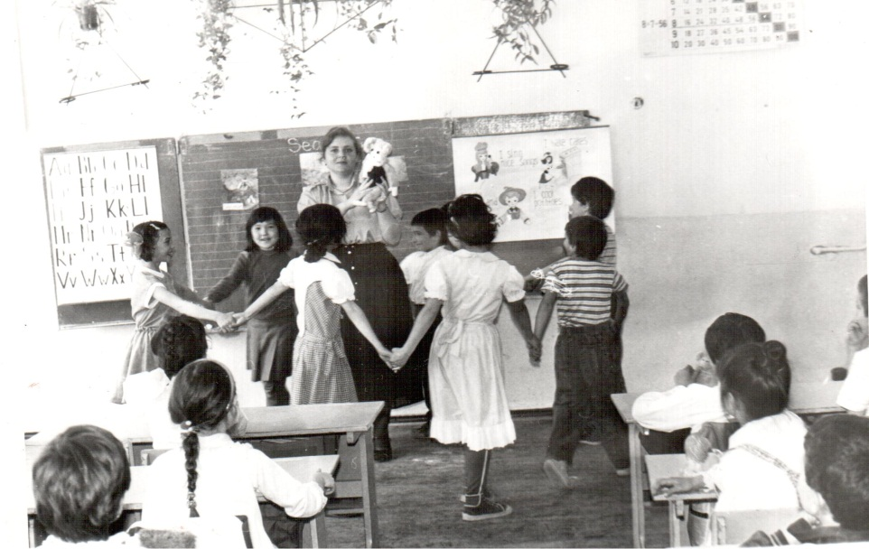
Nowadays an early start in teaching foreign languages is a norm at school. When I first began my teaching career in 1990s it was something new because schoolchildren in Russia started studying foreign languages from the age of 10. My first steps in early teaching I began making in 1991 with the form of six-year-old children within a regional experiment.

Slide 5
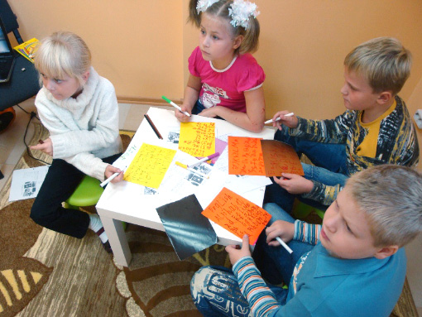
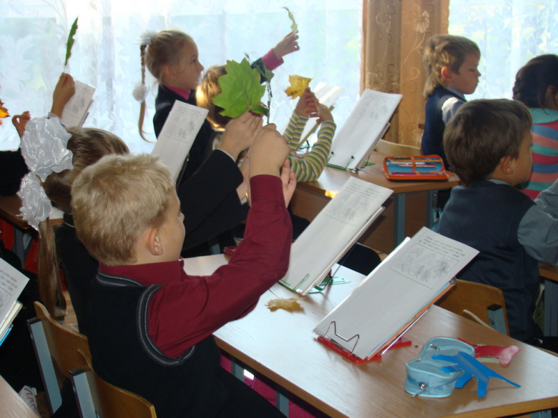
I was so caught by the experiment that continued taking groups of early English learners till it became a must in our country in 2005. The main thing I’ve learnt from this experiment is a teacher should always motivate students for further learning according to their age and interests.
At primary school I use playing methods of teaching.
I use toys, pictures, objects, masks, everything that can draw my pupils’ attention. At the lessons we dance, play, sing songs, guess riddles and do puzzles. It’s exciting and not intrusive for them.

Slide 6
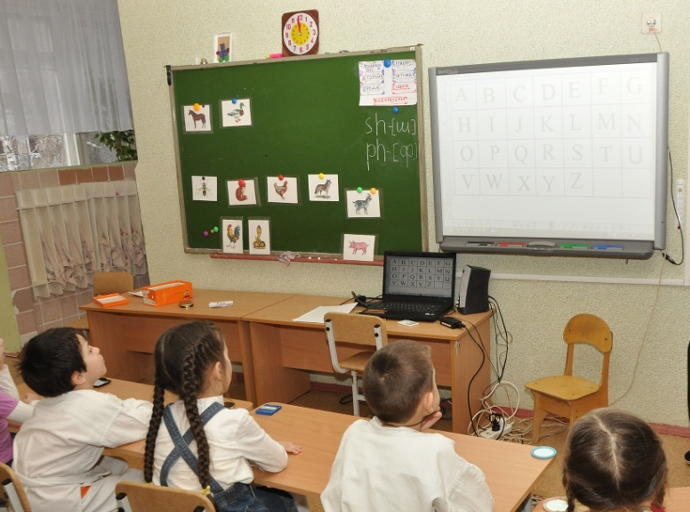
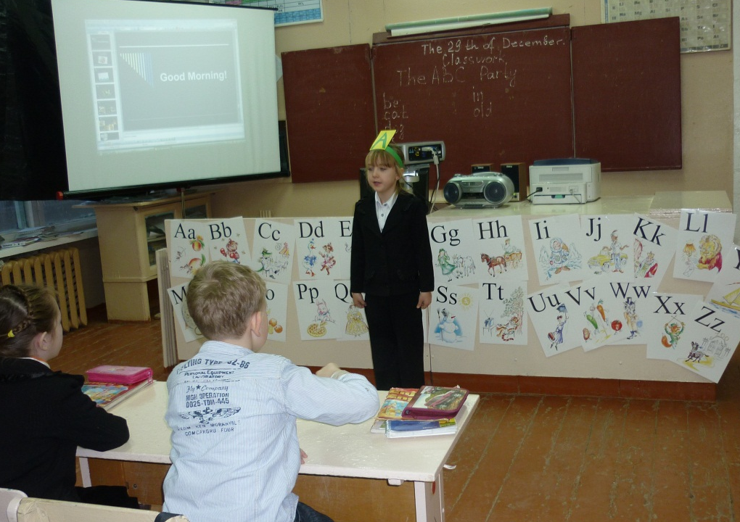
It’s nice that some school rooms are equipped with computers and whiteboards. It makes the process of learning more interesting. As for me I have a computer and a projector in my English classroom, and I use the Smartboard software at the lessons.
Kids are very fond of holidays, that’s why we make holiday lessons too. Here are the themes of some holidays: “ABC-party”, “Alice’ birthday”, “Mother’s day”, “English nursery rhymes”.

Slide 7
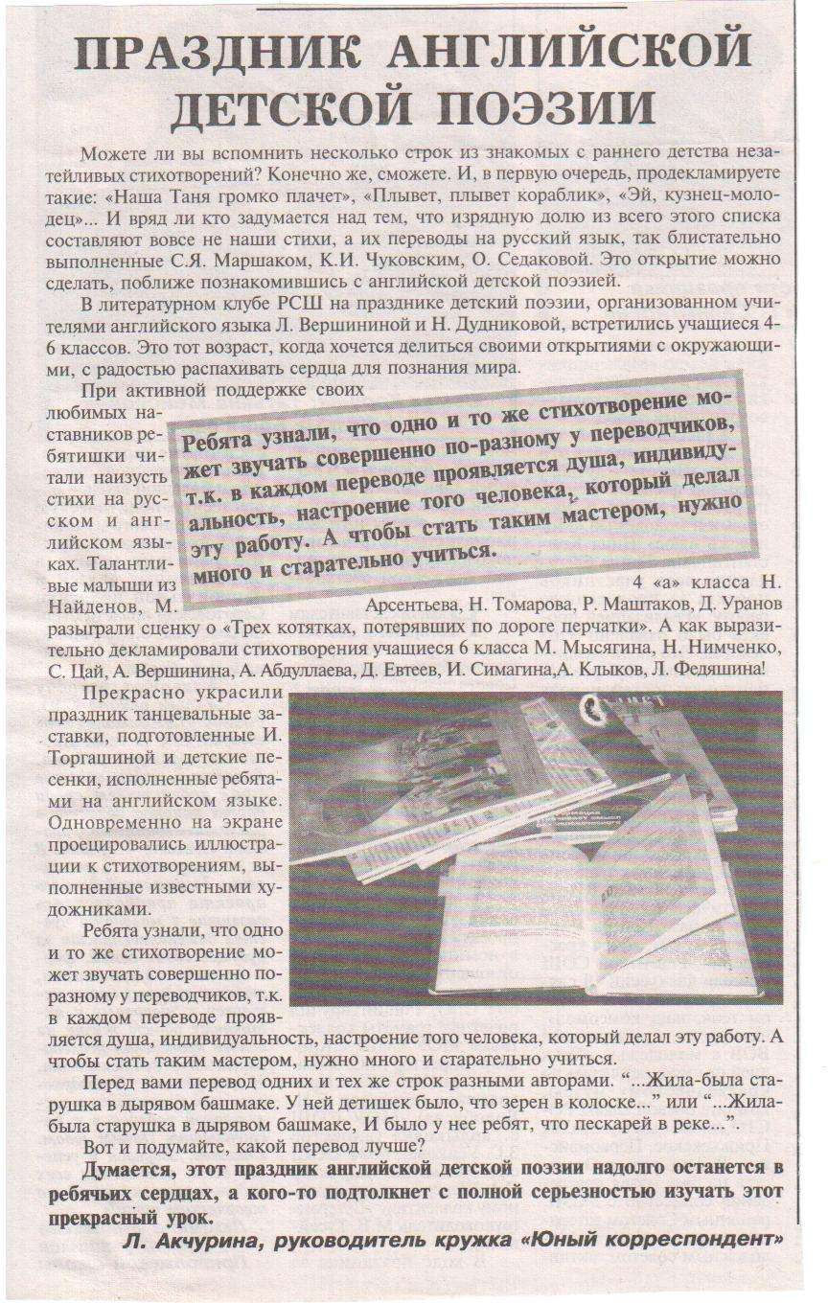
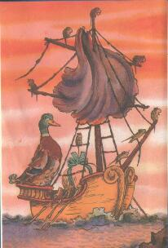
There was an article about the holiday of English nursery rhymes in the district newspaper “Znamya Pobedy”

Slide 8
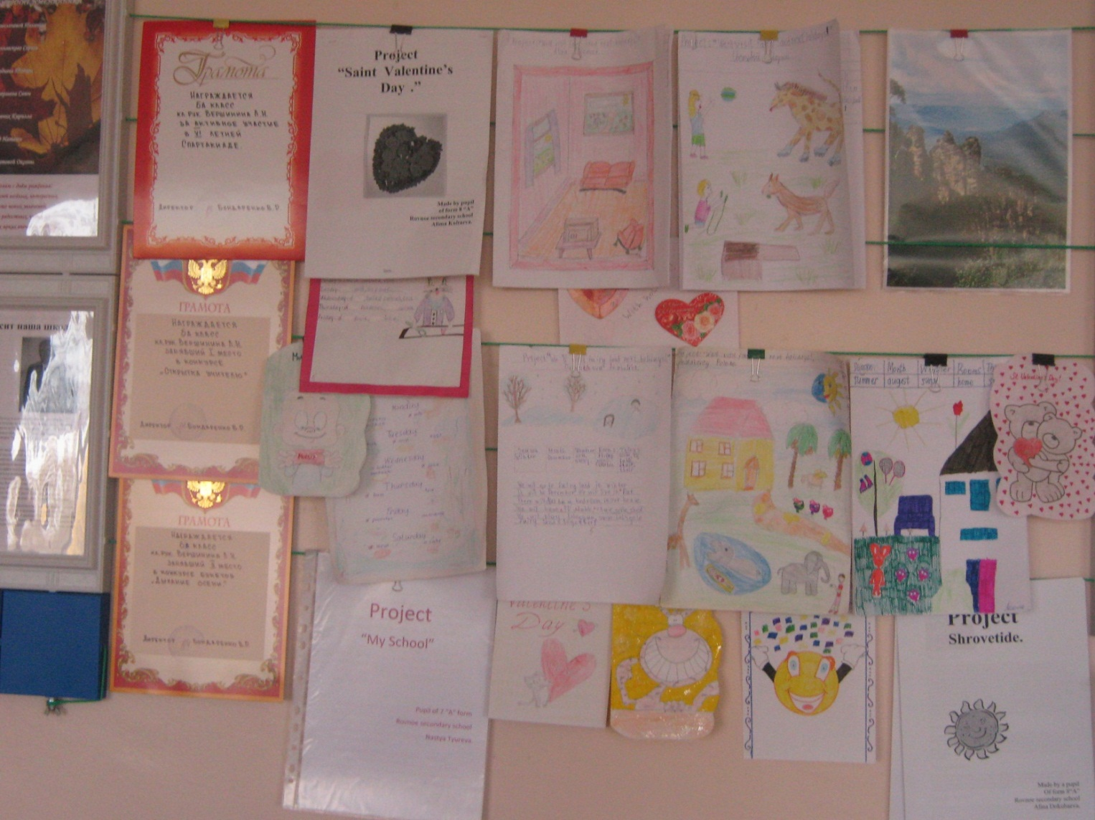
From the early age the pupils begin making projects. Their first projects are “My first ABC book”, “School menu”, “Writing fairy tales” and others. Have a look at the stand with some project works in the English classroom.

Slide 9
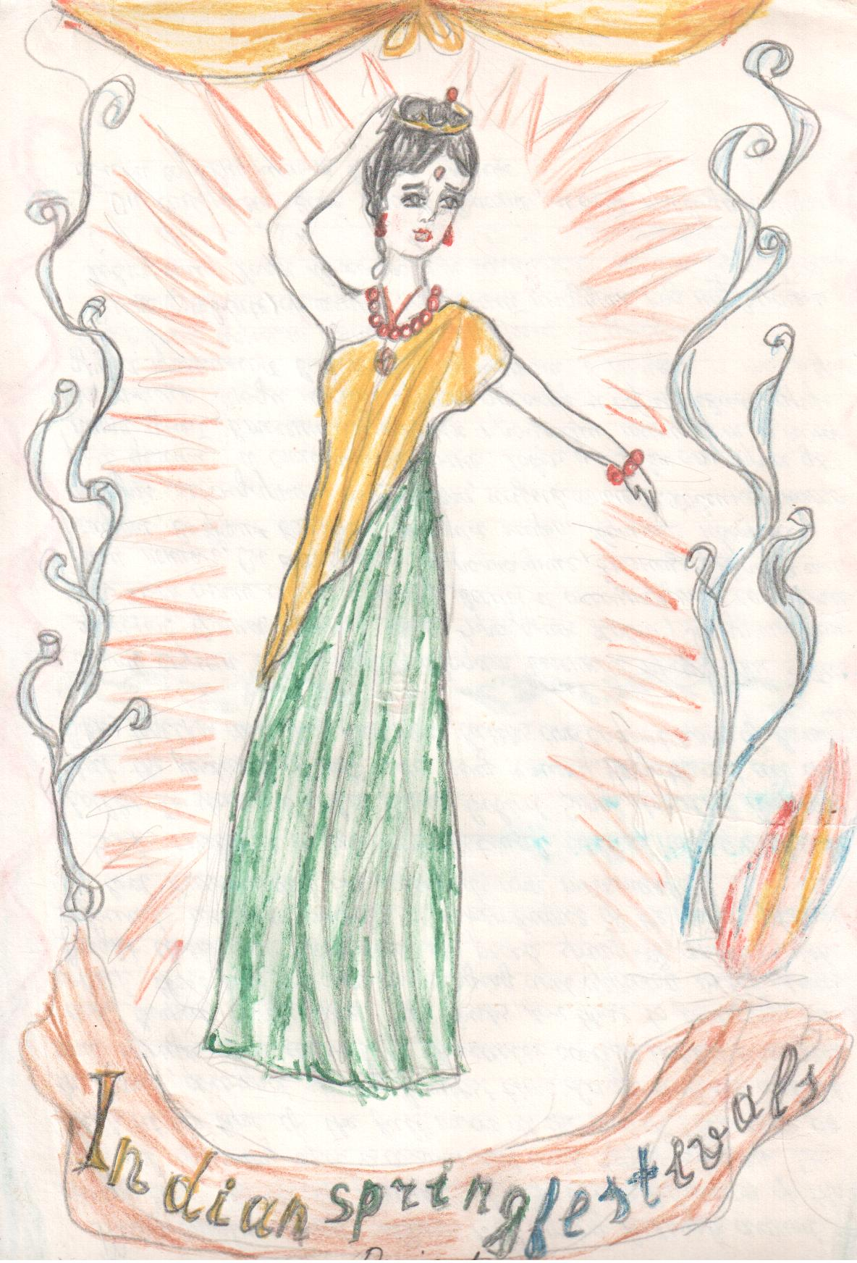
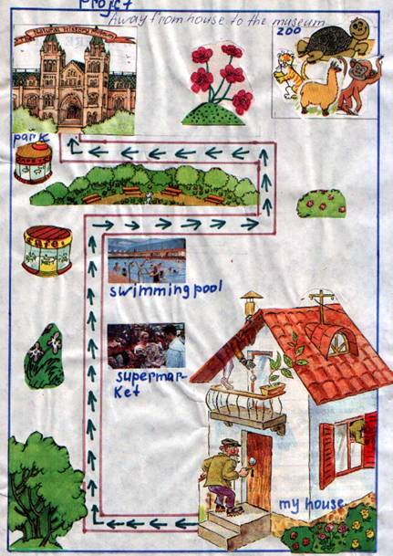
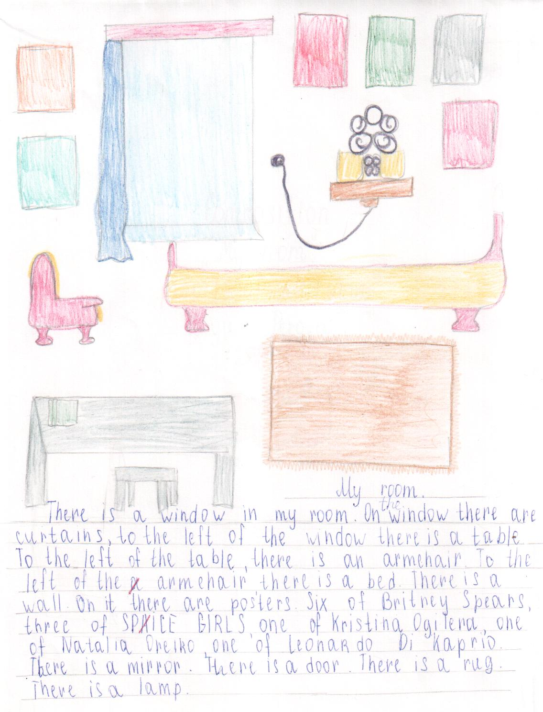
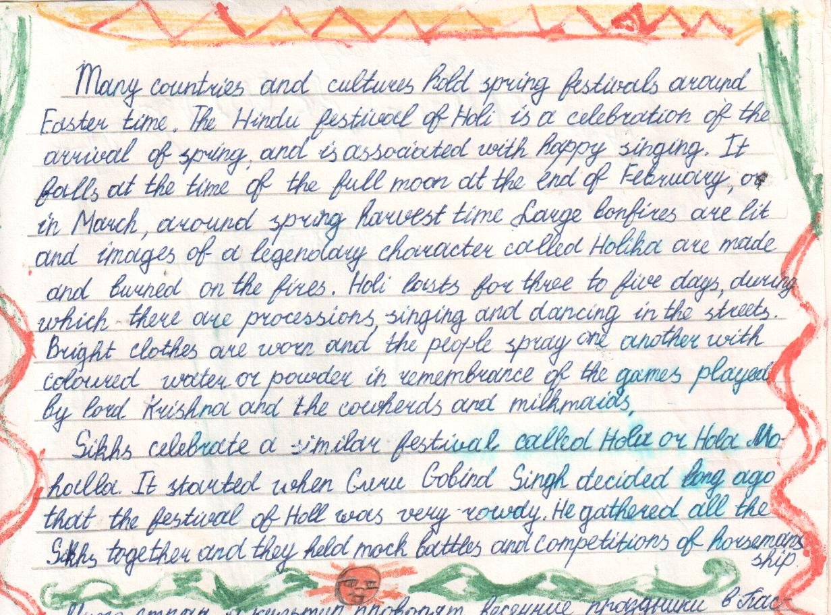
Some other projects made by pupils

Slide 10
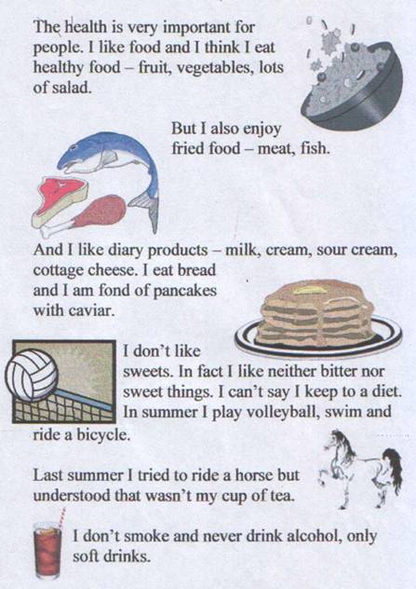
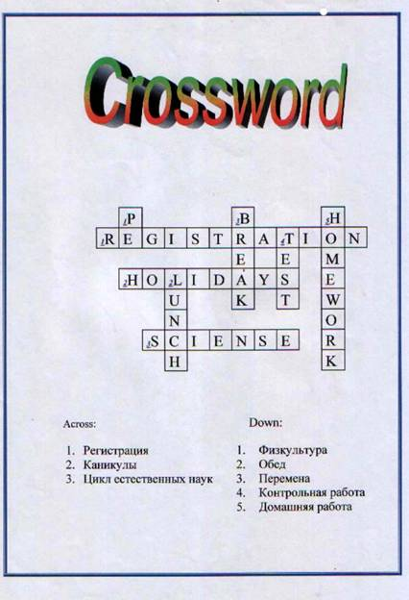
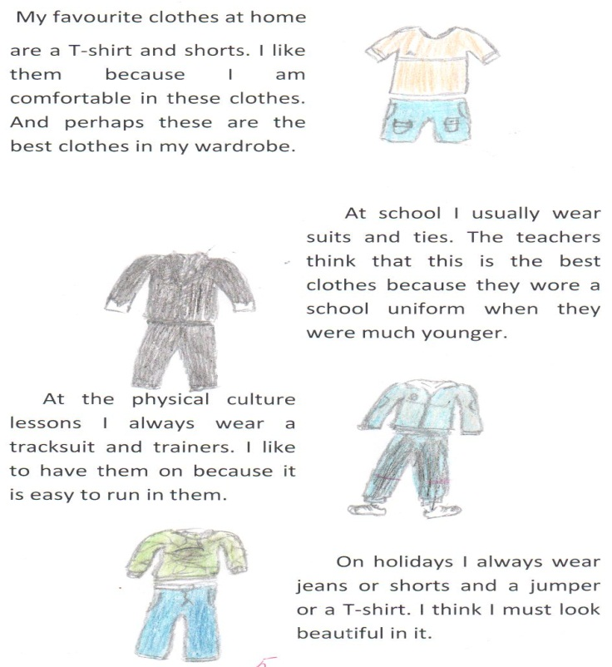
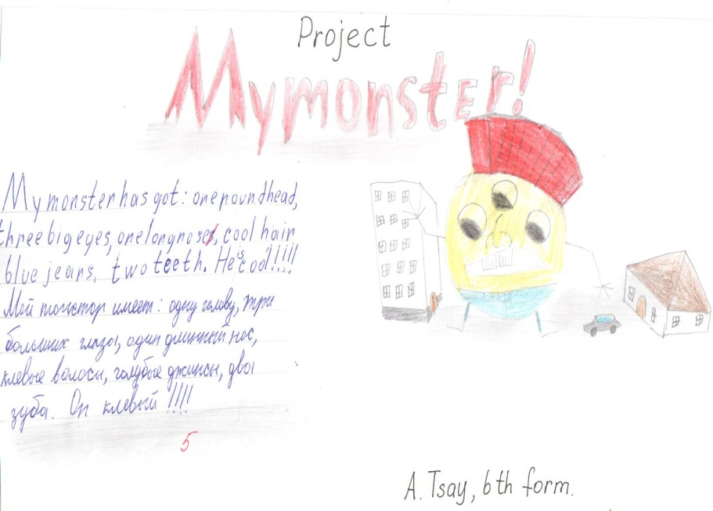
ai
_____

Slide 11
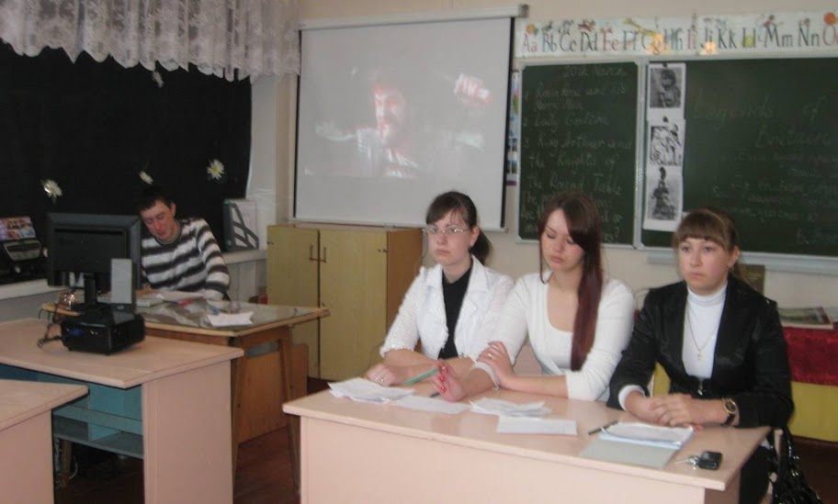
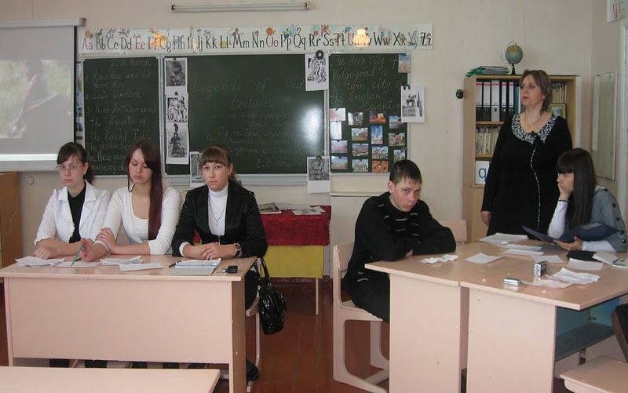
The use of projects is a powerful means to stimulate pupils’ creativeness especially if the work on the subject is organized in a group. Such work is eventually ends with the project defence where the pupils must show some material product created during their work. At the English lessons we make research, informative electronic projects. The work on the project demands knowledge from many spheres, that’s why we have to make integrated projects on geography, literature, history, art, and even physics.
The group defence of the project in the 11th form “Legends of Old Britain”. The students studied the legends of King Arthur, Lady Godiva and Robin Hood and then in their research tried to prove if these characters were real or invented by folk.

Slide 12
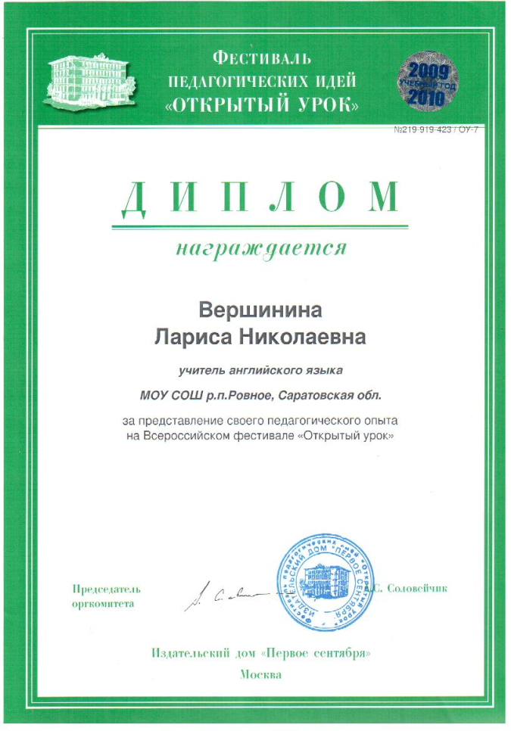
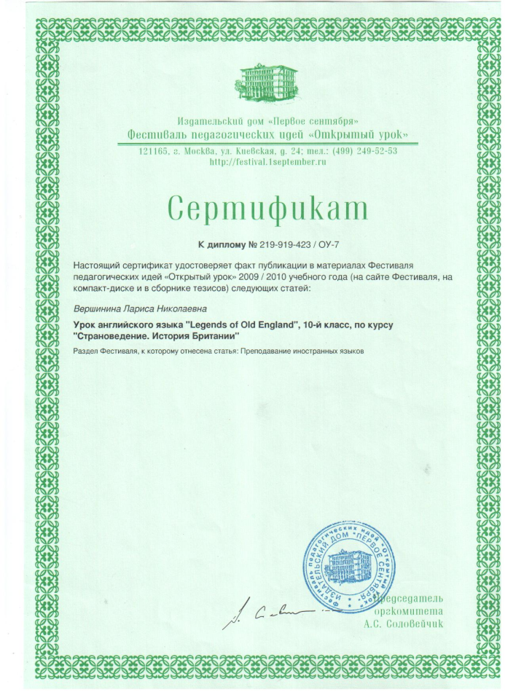
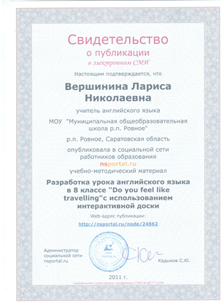
The project “Legends of Old England” was presented at the All Russian pedagogical festival “Open Lesson” and published in its materials.
I try to put the plans of my best lessons in the Internet on teachers’ sites to share the experience with colleagues and to get their responses and assessment.

Slide 13
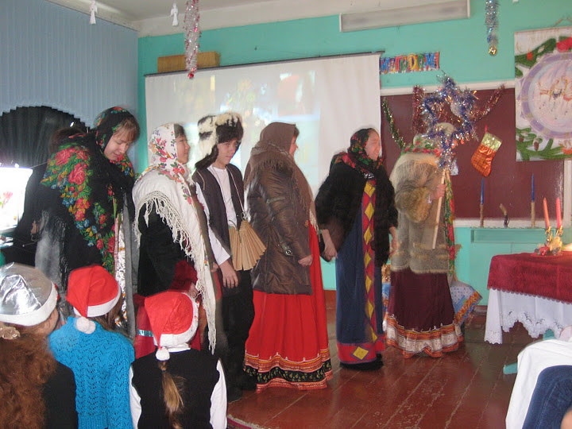
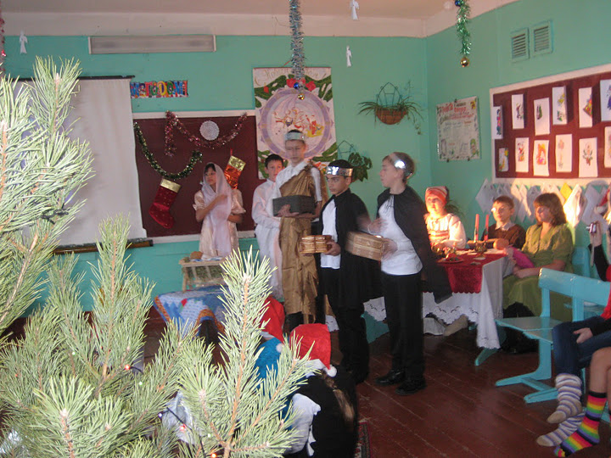
A large-scale project “Christmas” was carried out in the 8th grade. It united not only the pupils but the teachers as well, because the teachers of English, art, handicraft, literature and physics participated in it. The defence of the project took place on Christmas Eve and was a tremendous holiday at school. Pupils made Christmas ornaments, prepared Christmas dishes and decorations, made reports about English Christmas plants and traditions, compared Russian Ded Moroz and Santa Claus and wrote a letter to Santa in Finland. They also showed Russian Christmas traditions.

Slide 14
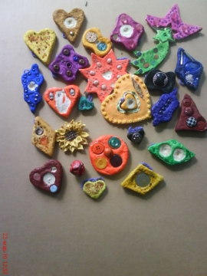
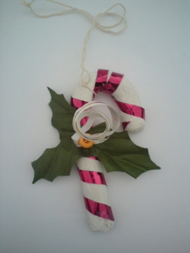
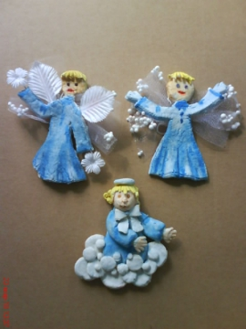
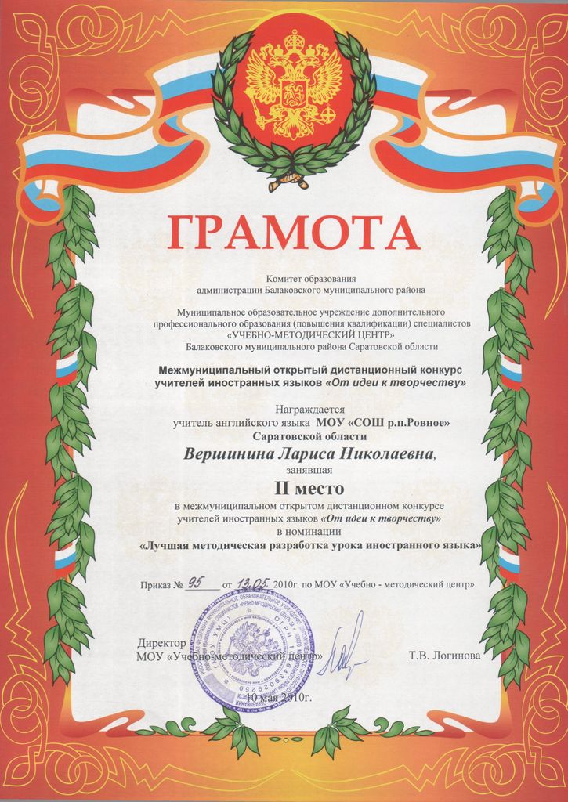
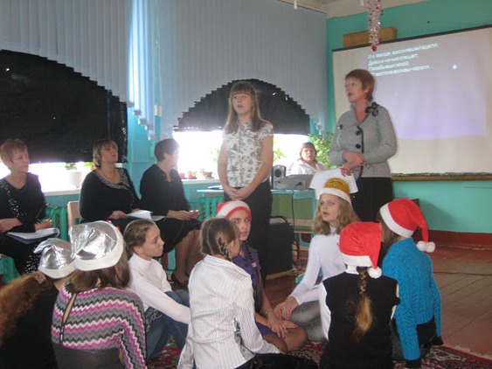
Christmas decorations made of salted dough by the pupils for the lesson “ Christmas”. The plan of the lesson was sent to the regional competition “From an idea to creativity” and won the second prize.

Slide 15
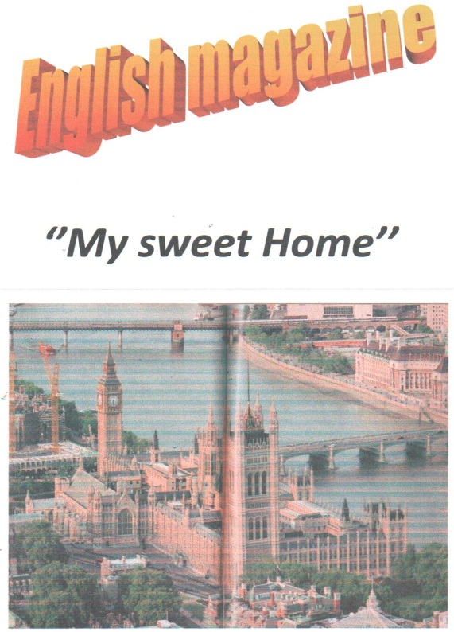
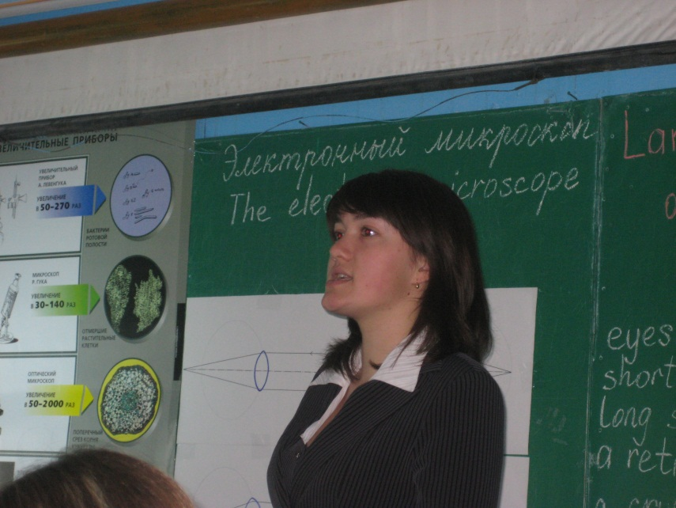
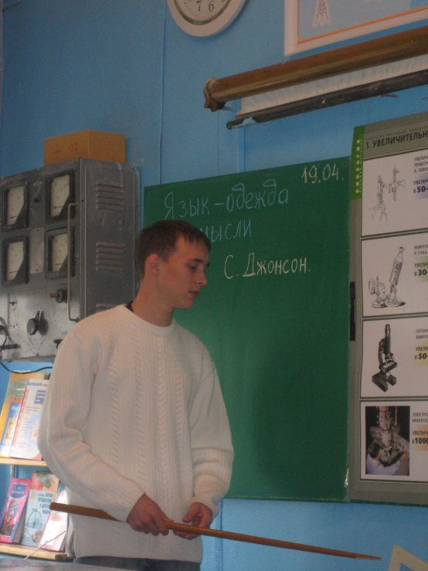
One more interesting project is a joint project on geography and English “The influence of geographical position on people’s lifestyle”. The result of this lesson is two magazines made by pupils.
It seems impossible, but we managed to give an integrated lesson “English + physics” on the theme “The electronic microscope”. It was given at the district teachers’ conference and received high marks.

Slide 16
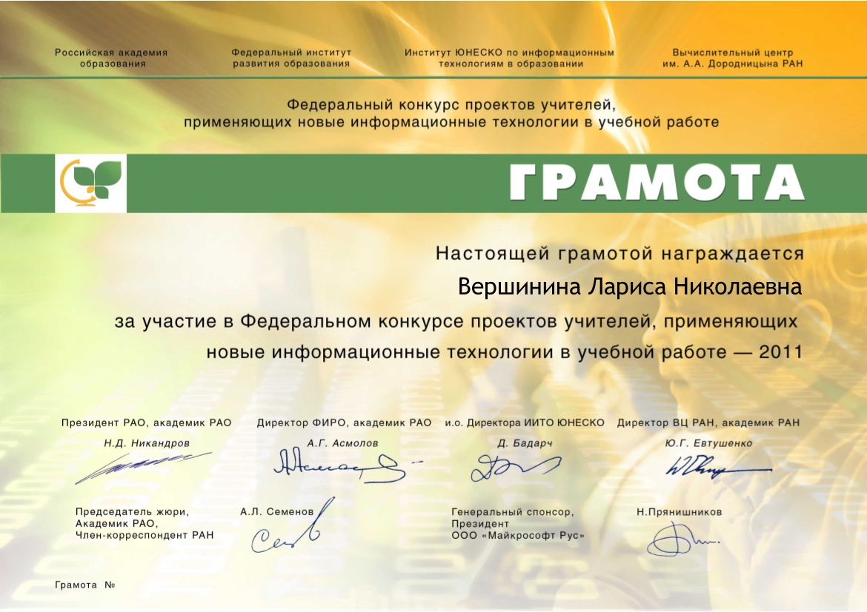
I presented my experience on the use of project method of teaching at the federal competition of teachers using new information technologies in their work in 2011.

Slide 17
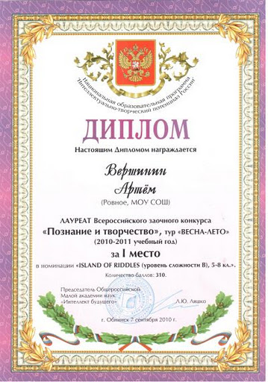
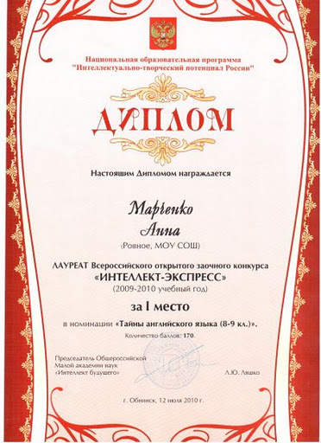
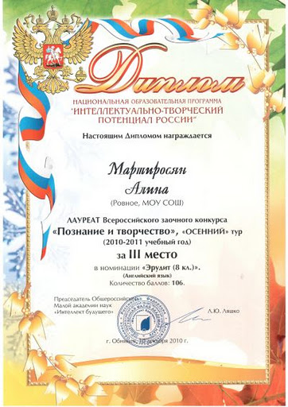
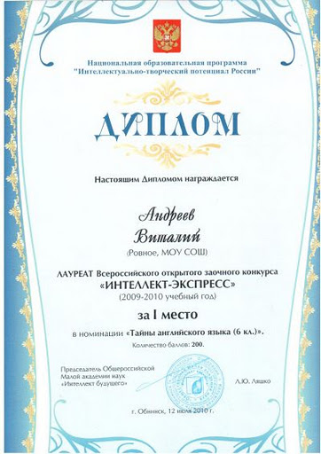
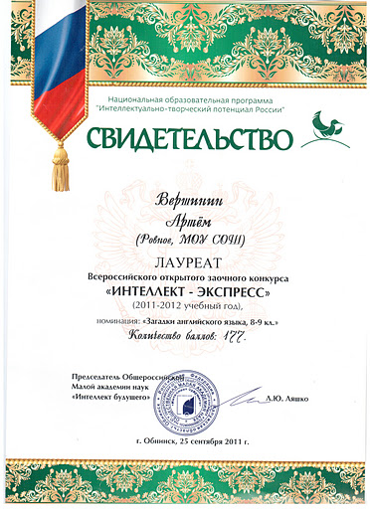
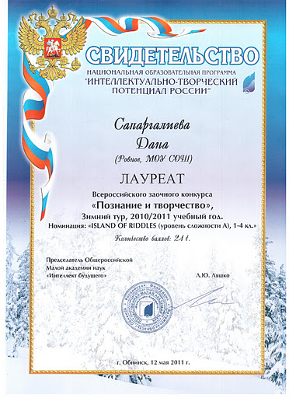
My pupils regularly take part in different English language competitions and become winners. It also motivates them a lot.

Slide 18
The method of critical thinking helps develop pupils’ skills. I use:
Cluster Method/Mind maps
Popular
It can tell us a lot about the world
Watching TV
Is important
You can meet many interesting people
Hobby
Going in for sport
travelling
Reading
It teaches us to develop our mind and body
Is interesting
Is useful
We learn a lot of new things

Slide 19
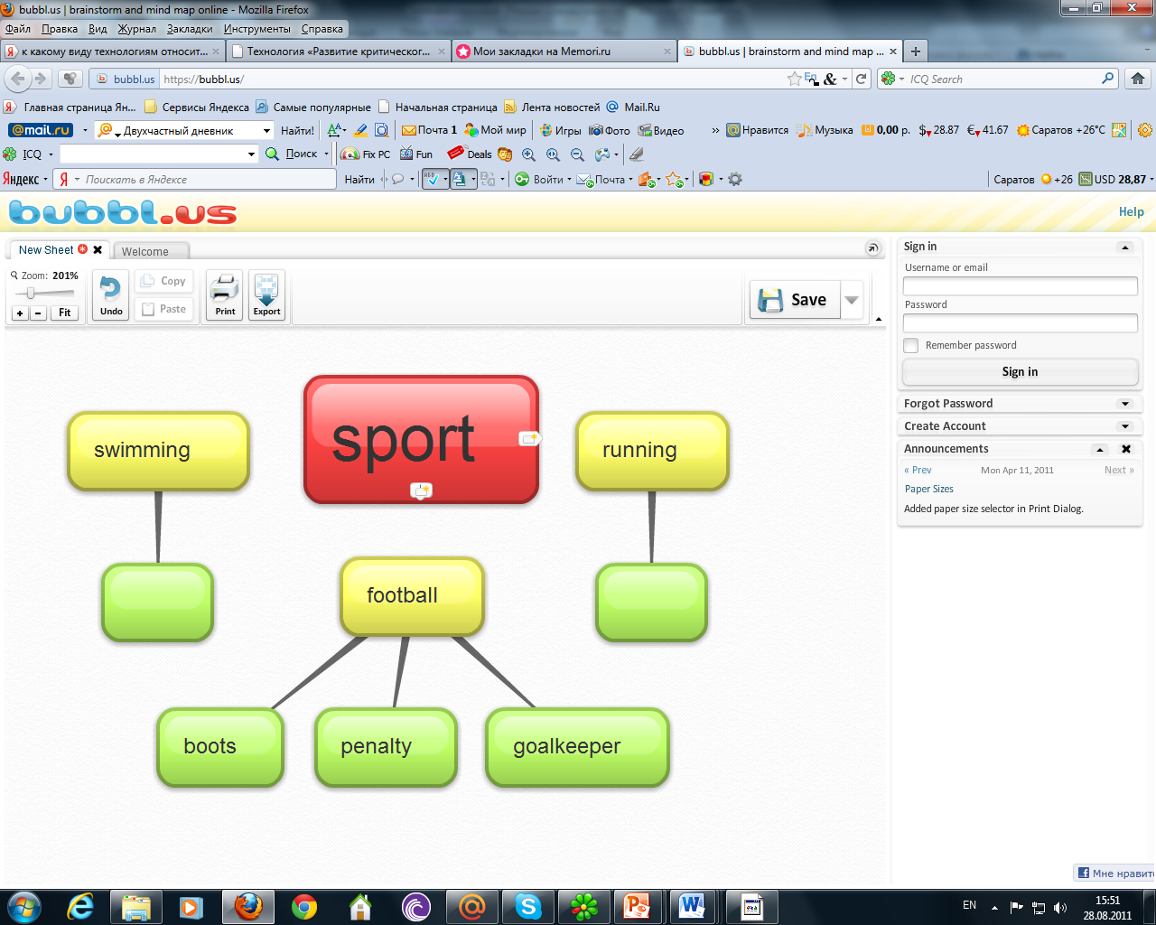
On-line Mind maps

Slide 20
Insert
I – interactive N - noting S - system E - effective R - reading and T - thinking | Самоактивизирующая системная разметка для эффективного чтения и размышления | " V " - know " + " – new " - " – thought in another way " ? " – don’t understand, have some questions

Slide 21
Make notes in the text using INSERT method
“Healthy living guide”
Symptoms of chronic tiredness
1. Depression
2. Irritation
3. Headaches
4. Insomnia
5. Teeth aches
6. Backaches
7. Sleepiness
8. Temperature
9. A sore throat
10. No appetite

Slide 22
Two parts diary
9 th grade.
Seven deadly health sins
Information of good and bad habits | A Student’s Commentary
1. People can die of pride, envy or anger. | I don’t agree. There are many people which are very angry, but they live happy, have got money and a good job.
2. Obesity and physical inactivity are known form the ancient times | I agree. I think people like eating tasty food from the ancient times. That is why they have led to obesity.
3. Too much or too little sleeping is dangerous. | I am of opinion that only too little sleeping is dangerous for health.
4. Drinking alcohol and smoking are bad habits. | Quite agree.
5. Eating between meals and skipping breakfast is unhealthy. | Of course, but all the people are very busy today. They haven’t got an opportunity to have regularly meals.
6. Poor health habits double the chance of dying or lead to diseases. | I agree. Many people for example die of cancer, because of smoking and drinking.
7. Sleeping so much as your want is good for health. | That true. Sleeping is useful.
8. Eating regularly is a good way to live. | Quite true. I’d like to have a diet too.

Slide 23
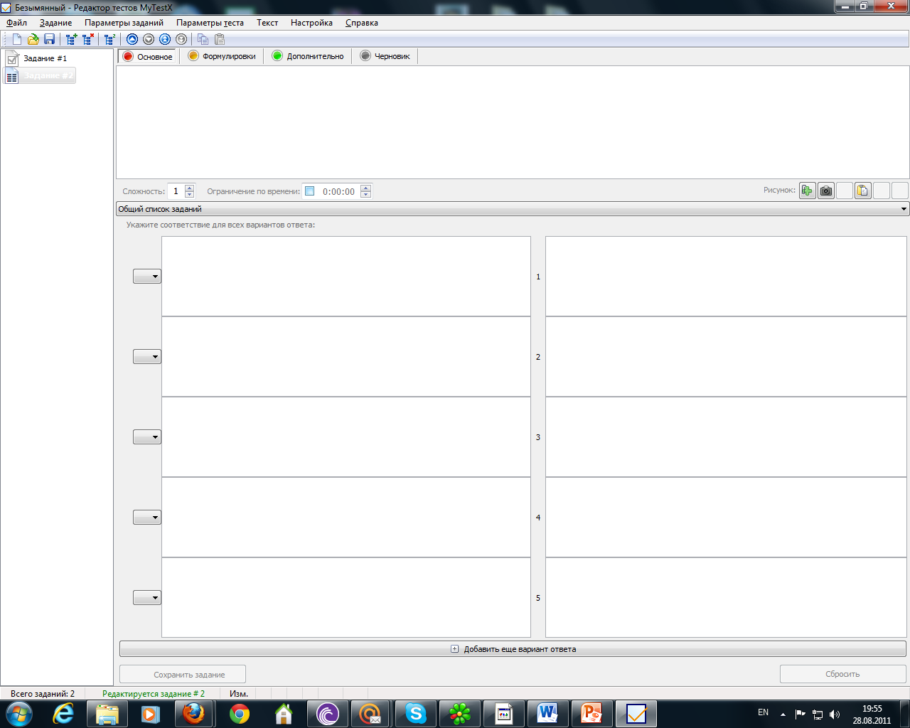
Modern forms of control
The program of making electronic tests “My Test”

Slide 24
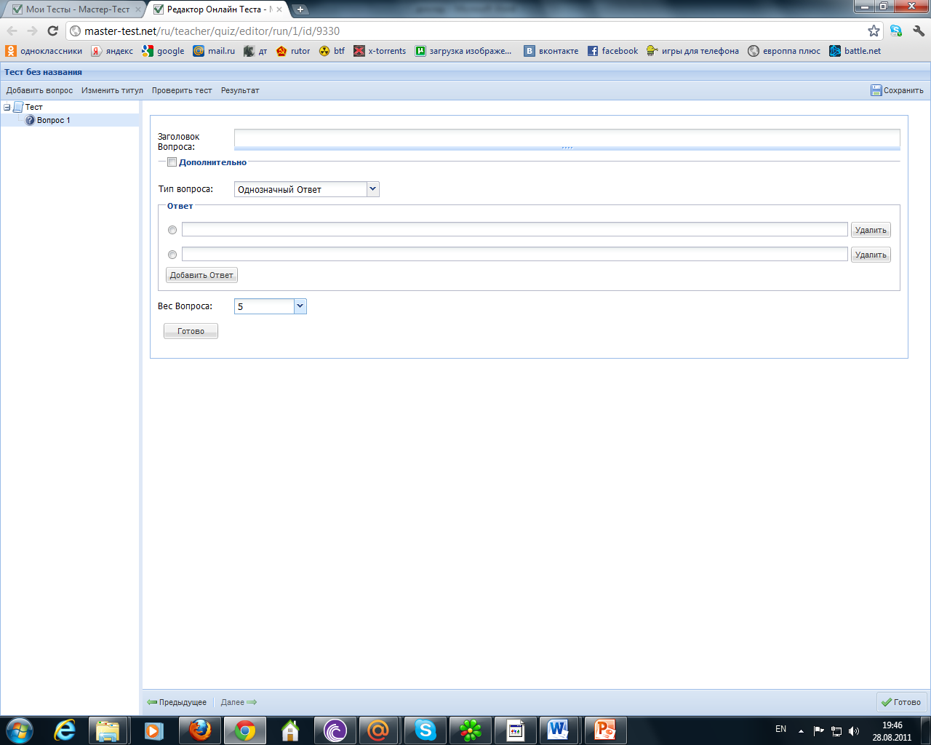
On-line test editor “Master test”

Slide 25
The results of using new teaching technologies. The dynamic of pupils’ knowledge quality for the last 3 years

